Slide 1

Database Systems: Design, Implementation, and Management 14th Edition
Chapter 1
Database Systems

Slide 2

National Economics University Faculty of Mathematical Economics
EP03.TITH1121 - DATA STRUCTURES AND ALGORITHMS: Trees
Instructor: Duc Minh Vu (MFE)
Email: minhvd [at] neu.edu.vn
3/13/2024
Data Structures and Algorithms in Python
2

Slide 3
Learning Objectives
Describe the features of a tree
Describe various types of tree traversals
Recognize three common applications where it is appropriate to use a tree
Describe the features of a binary search tree and the operations on it
Recognize the three common applications where it is appropriate to use a binary search tree
Describe the features of an expression tree and the operations on it

Slide 4
Some applications
Translating infix expressions to postfix form and evaluating postfix expressions.
CPU access—Processes are queued for access to a shared CPU.
Disk access—Processes are queued for access to a shared secondary storage device.
Printer access—Print jobs are queued for access to a shared laser printer.

Slide 5
Overview of trees

Slide 6
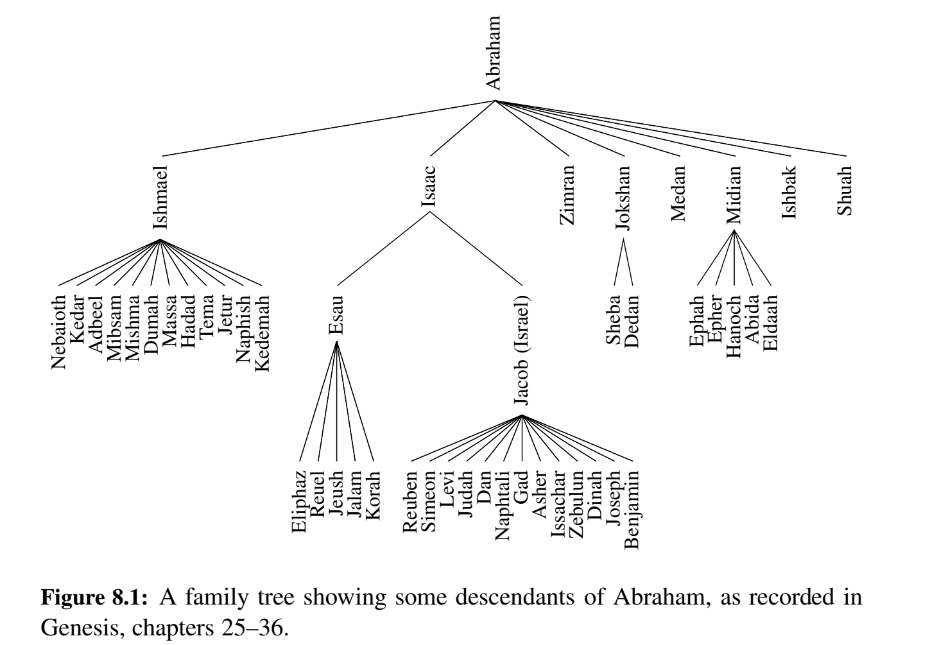

Slide 7
An overview of trees
In the linear data structures, all items except for the first have a distinct predecessor, and all items except the last have a distinct successor.
In a tree, the ideas of predecessor and successor are replaced with those of parent and child. Trees have two main characteristics:
Each item can have multiple children.
All items, except an item called the root, have exactly one parent. The root has no parent.

Slide 8
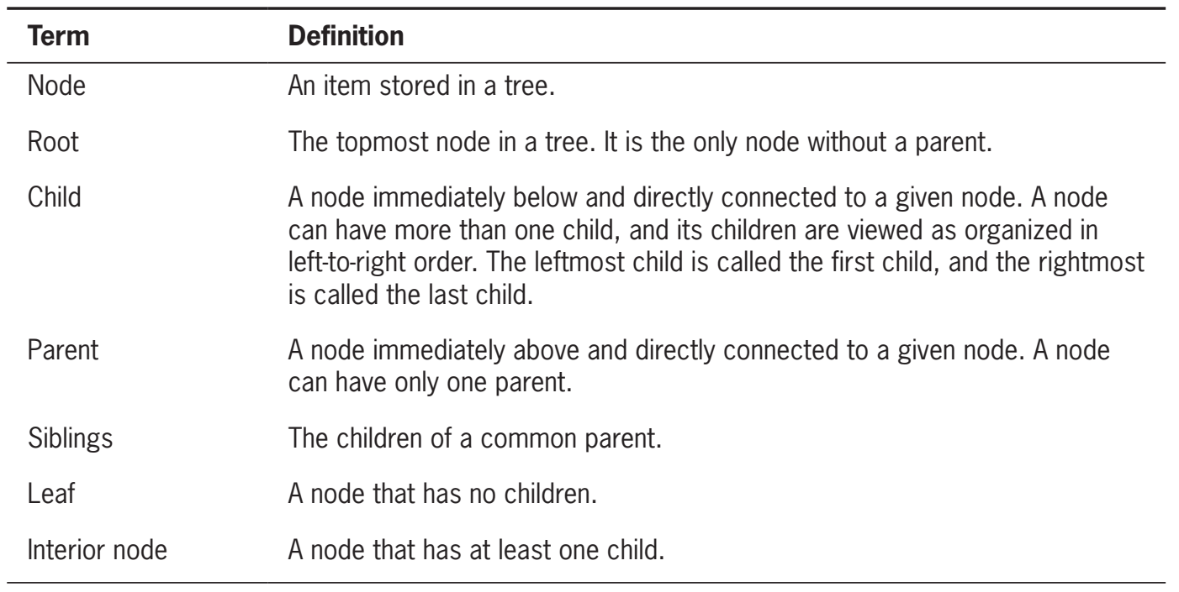
Tree Terminology

Slide 9
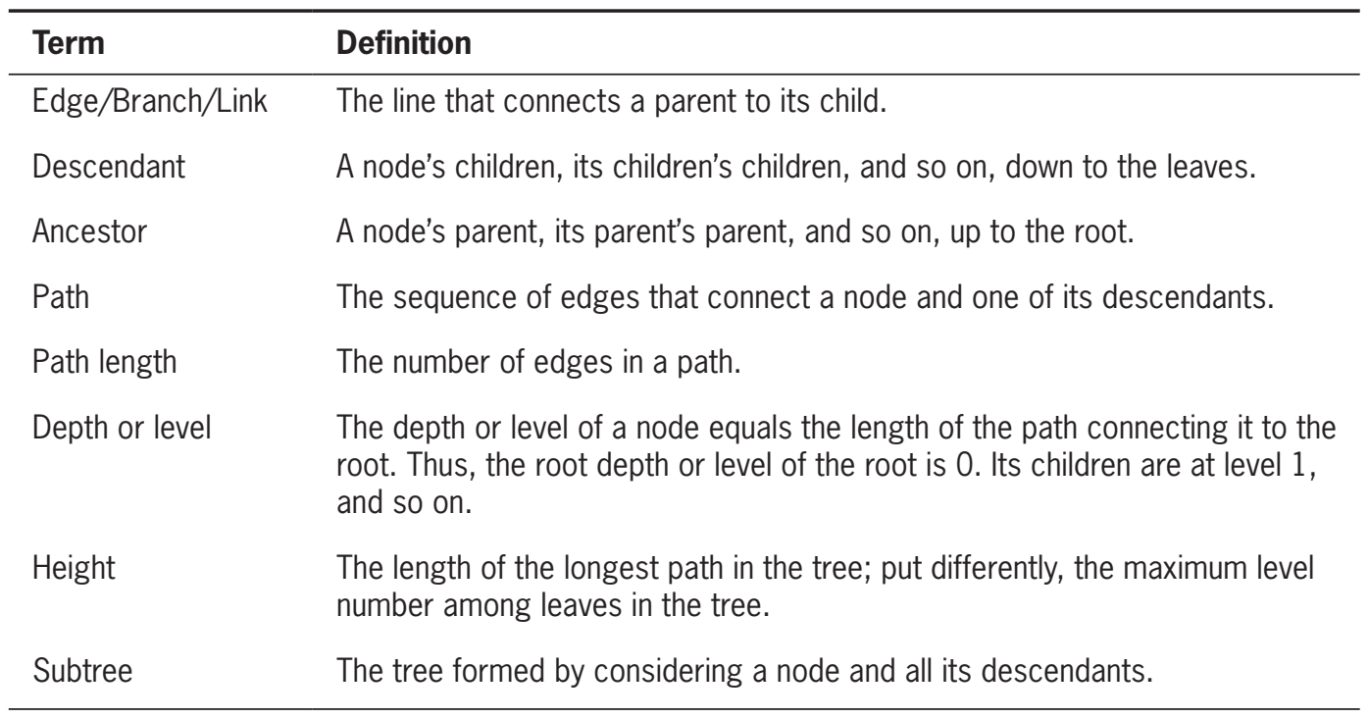

Slide 10
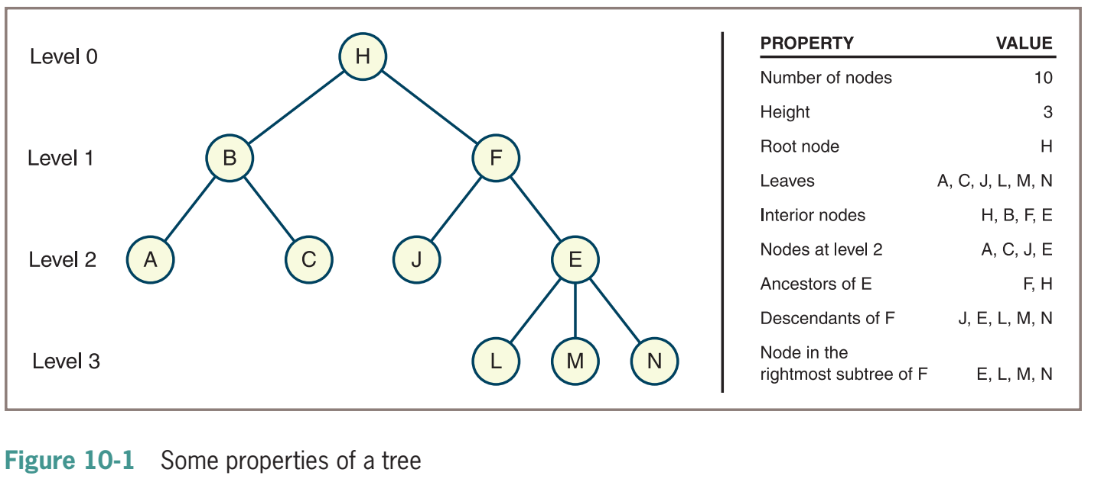

Slide 11
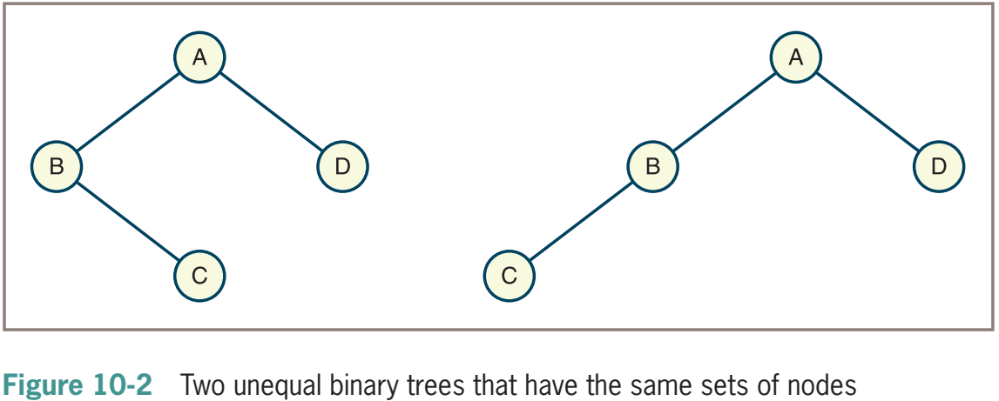
General Trees and Binary Trees
The tree shown in Figure 10-1 is sometimes called a general tree to distinguish it from a special category called a binary tree.
In a binary tree, each node has at most two children, referred to as the left child and the right child

Slide 12
Recursive Definitions of Tree
General tree—A general tree is either empty or consists of a finite set of nodes T. One node r is distinguished from all others and is called the root. In addition, the set T – {r} is partitioned into disjointed subsets, each of which is a general tree.
Binary tree—A binary tree is either empty or consists of a root plus a left subtree and a right subtree, each of which is a binary tree.

Slide 13
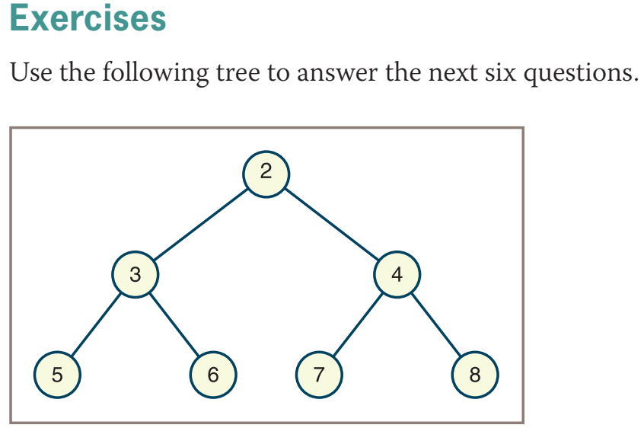
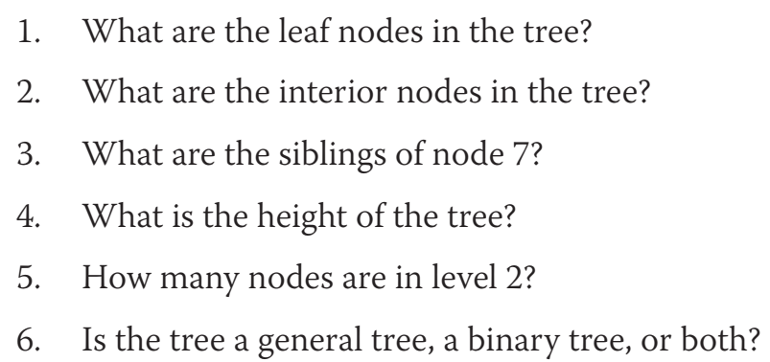

Slide 14
Some applications

Slide 15
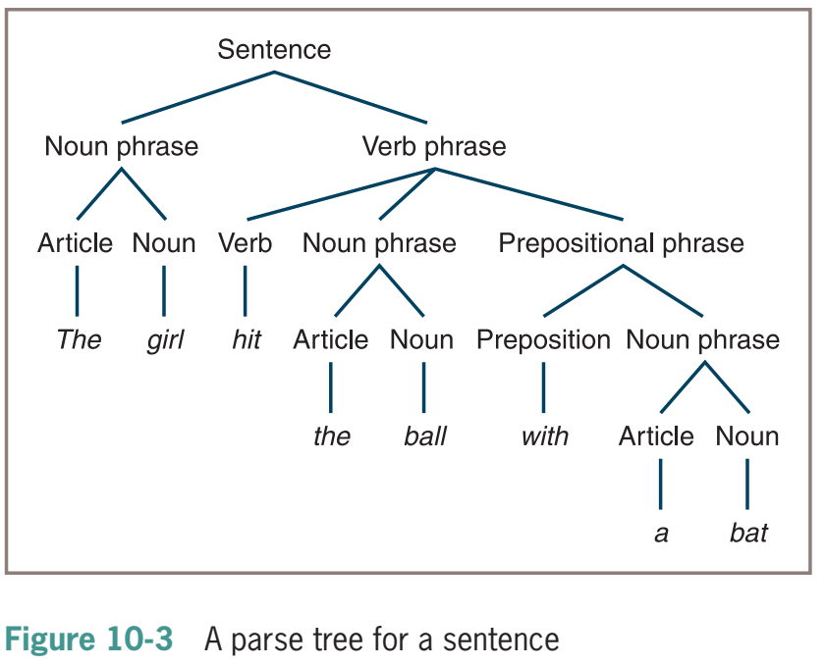

Slide 16
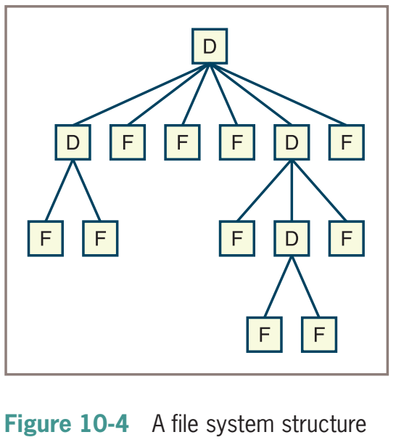

Slide 17
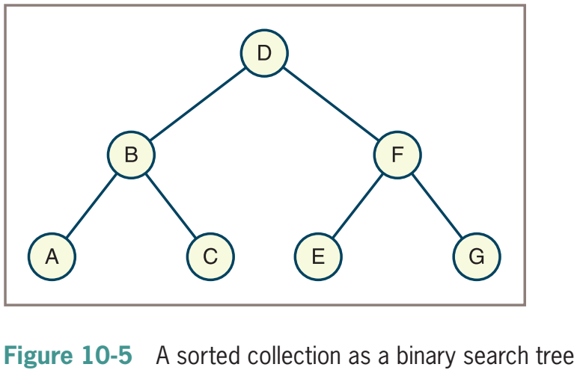

Slide 18
8.1. General Trees

Slide 19
8.1.2 The Tree Abstract Data Type
A position object for a tree supports the method:
p.element( ): Return the element stored at position p.
accessor methods, allowing a user to navigate the various positions of a tree:

Slide 20
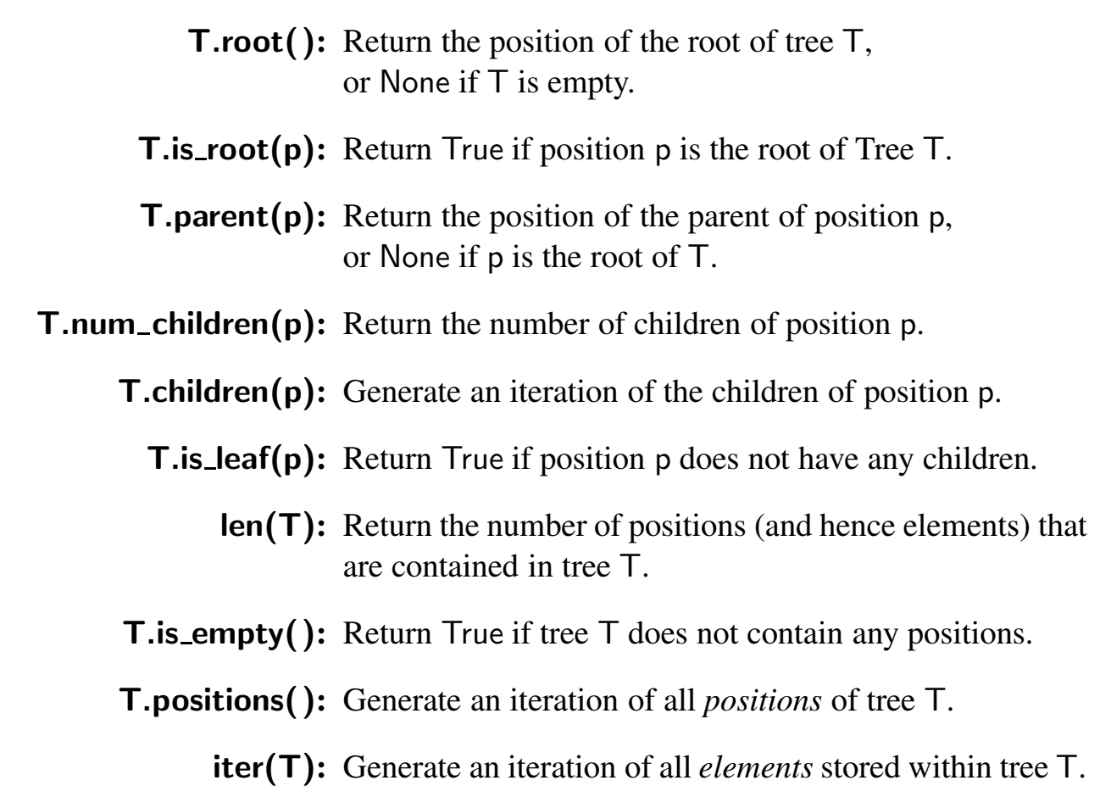

Slide 21
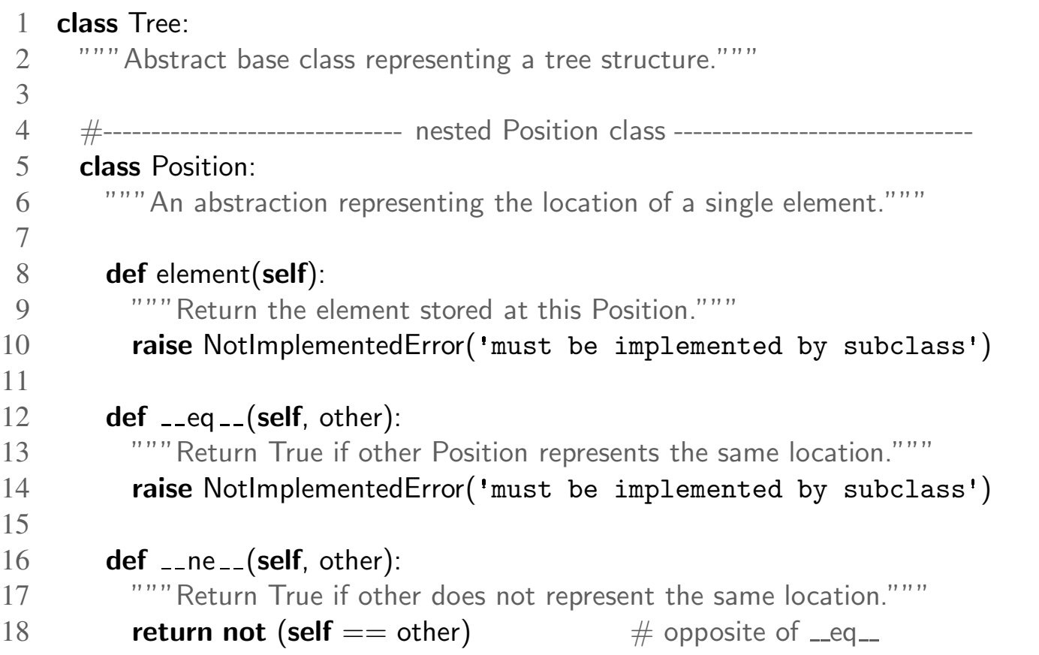
A Tree Abstract Base Class in Python

Slide 22
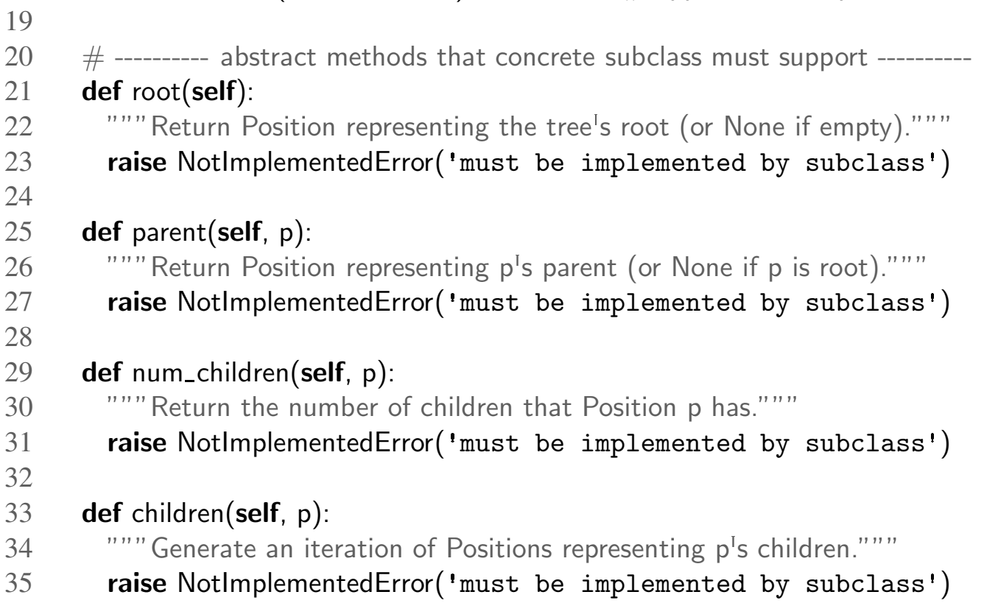

Slide 23
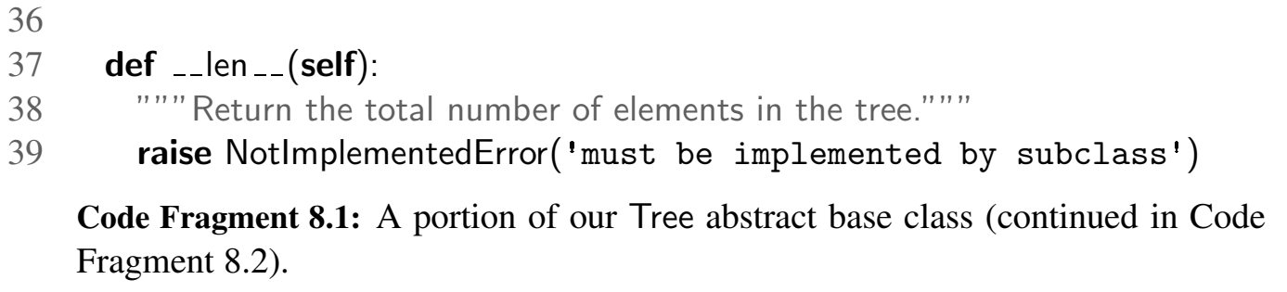

Slide 24
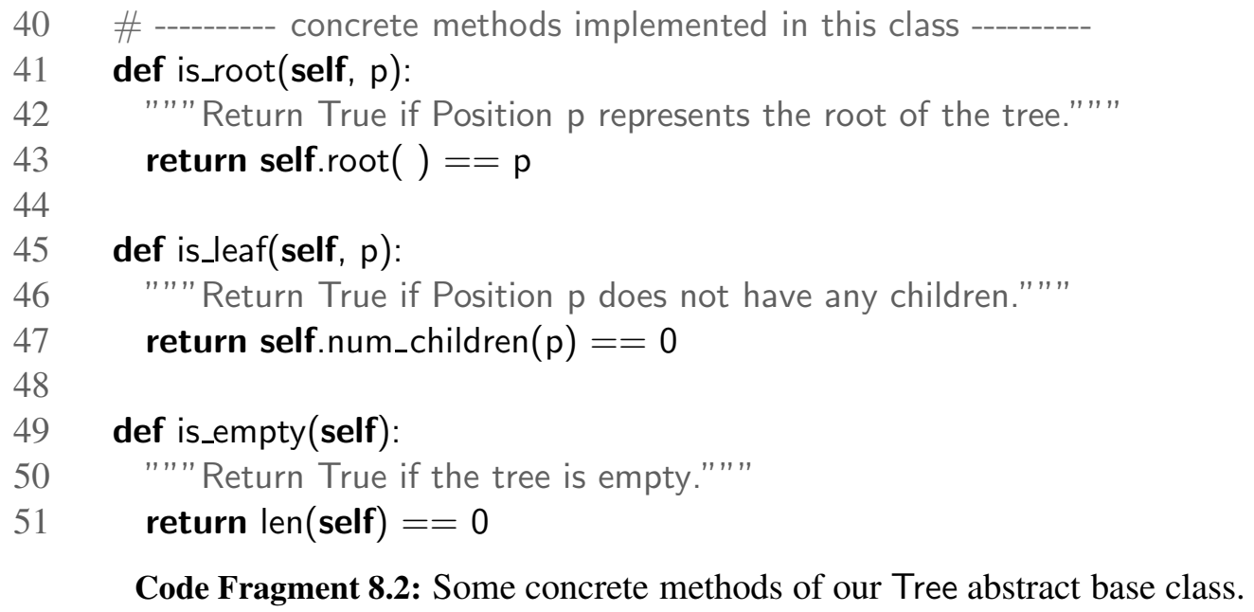

Slide 25
8.1.3 Computing Depth and Height

Slide 26
8.1.3 Computing Depth
Let p be the position of a node of a tree T . The depth of p is the number of ancestors of p, excluding p itself.
The depth of p can also be recursively defined as follows: • If p is the root, then the depth of p is 0. • Otherwise, the depth of p is one plus the depth of the parent of p

Slide 27
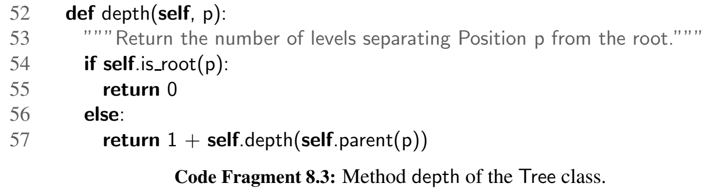

Slide 28
8.1.3 Computing Height
The height of a position p in a tree T is also defined recursively: • If p is a leaf, then the height of p is 0. • Otherwise, the height of p is one more than the maximum of the heights of p’s children.
The height of a nonempty tree T is the height of the root of T .
The height of a nonempty tree T is equal to the maximum of the depths of its leaf positions

Slide 29
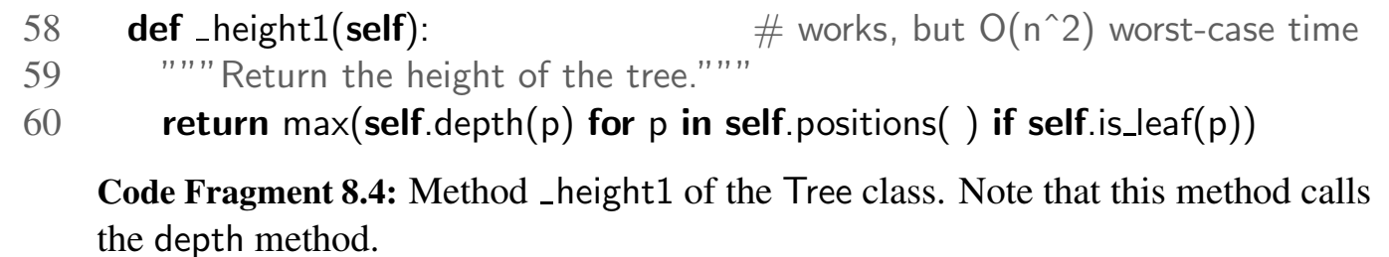
Complexity: O(n^2) where n is the number of nodes of the subtree with root p.

Slide 30
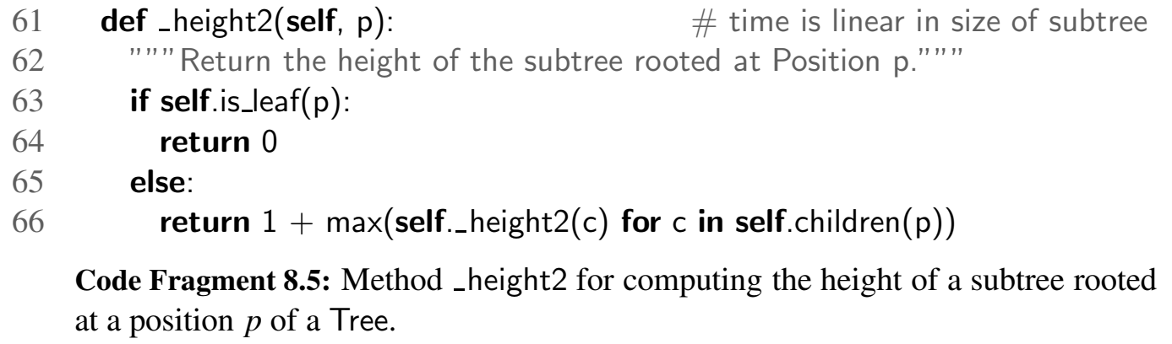
Complexity: O(n) where n is the number of nodes of the subtree with root p.

Slide 31
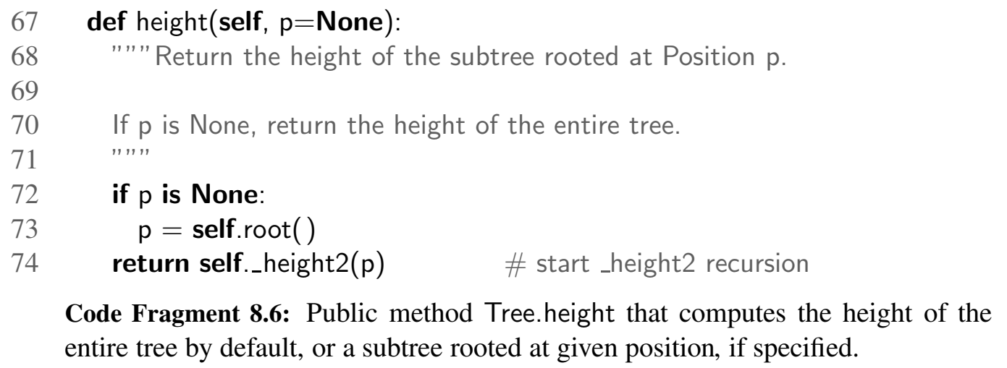

Slide 32
Binary trees

Slide 33
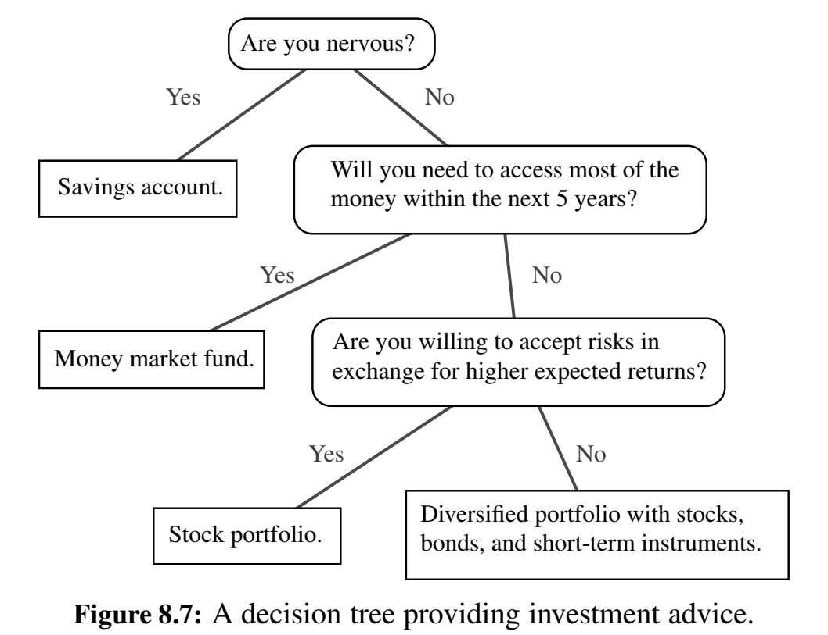

Slide 34
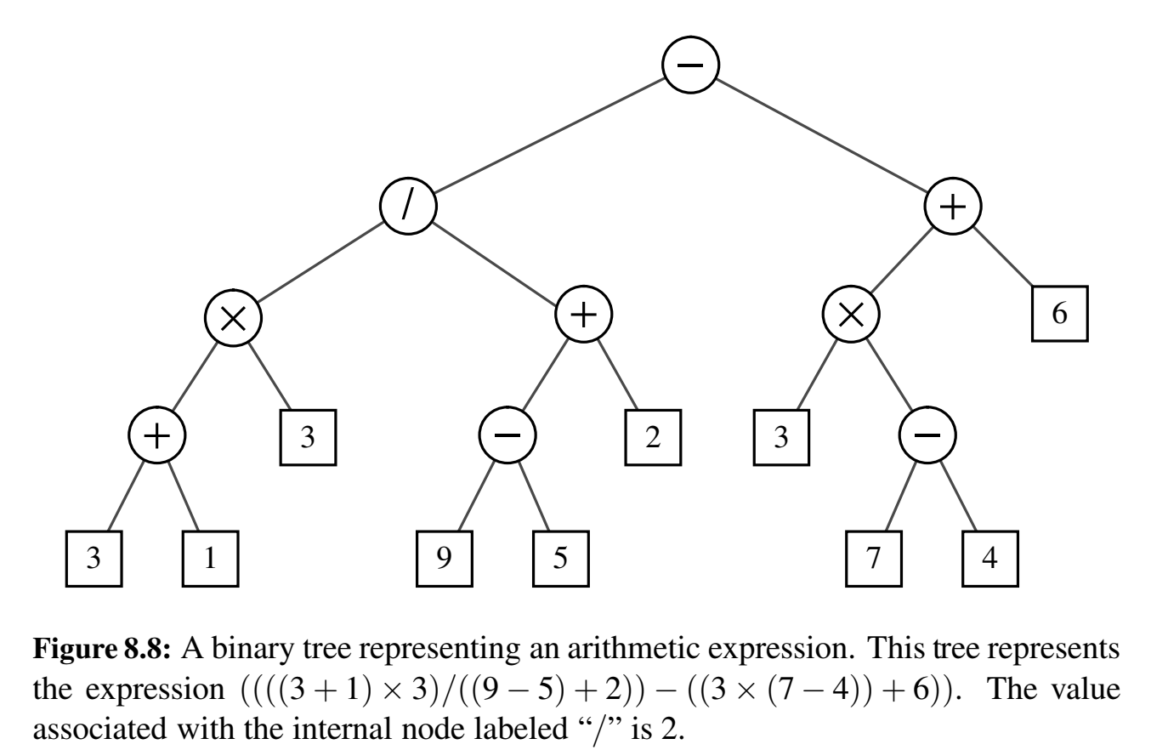

Slide 35
A Recursive Binary Tree Definition
A node r, called the root of T , that stores an element
A binary tree (possibly empty), called the left subtree of T
A binary tree (possibly empty), called the right subtree of T

Slide 36
8.2.1 The Binary Tree Abstract Data Type

Slide 37
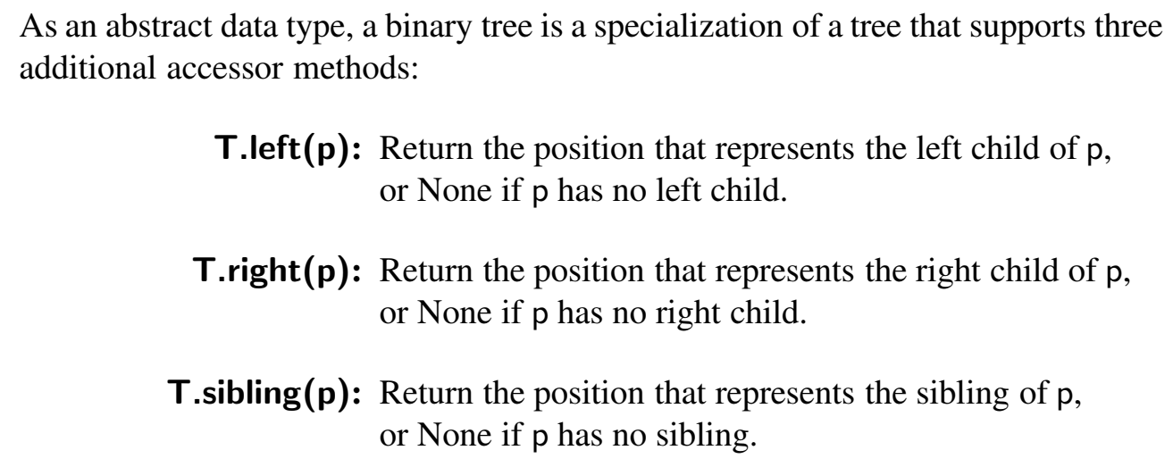

Slide 38
The BinaryTree Abstract Base Class in Python

Slide 39
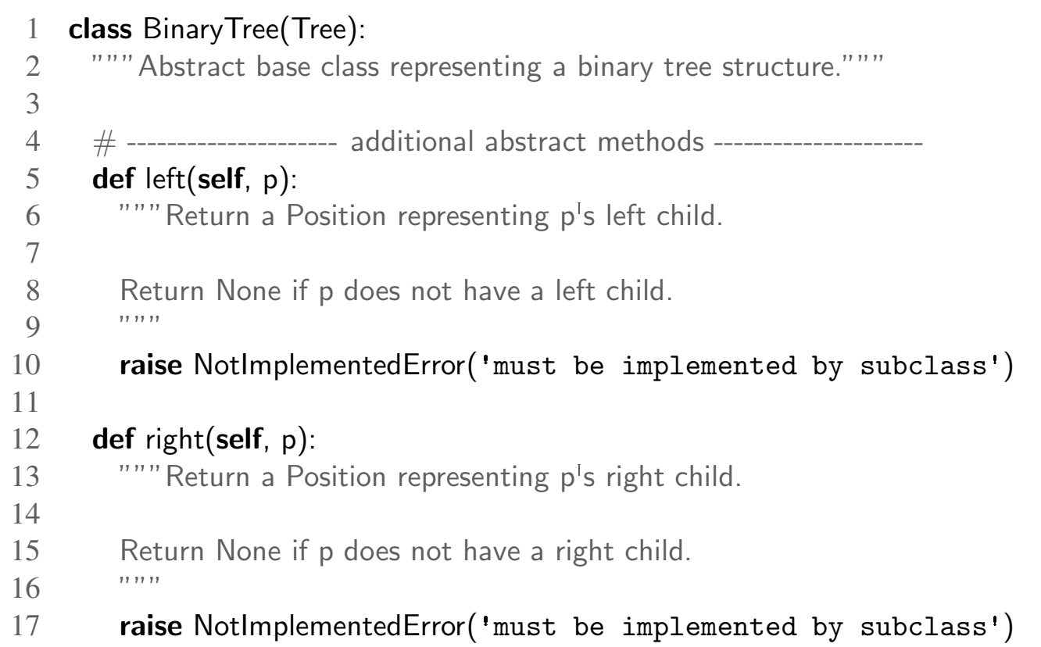

Slide 40
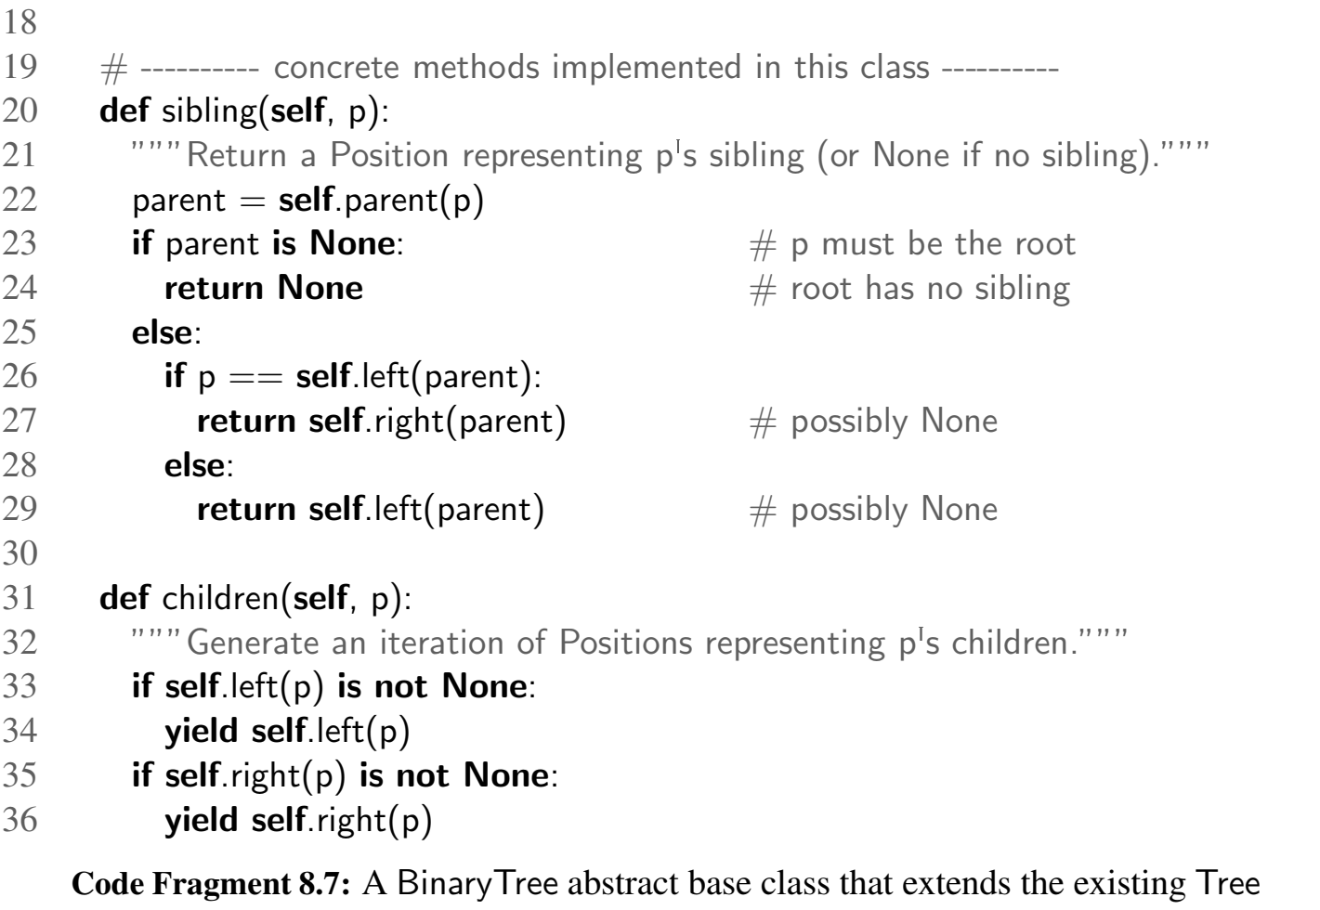

Slide 41
8.2.2 Properties of Binary Trees

Slide 42
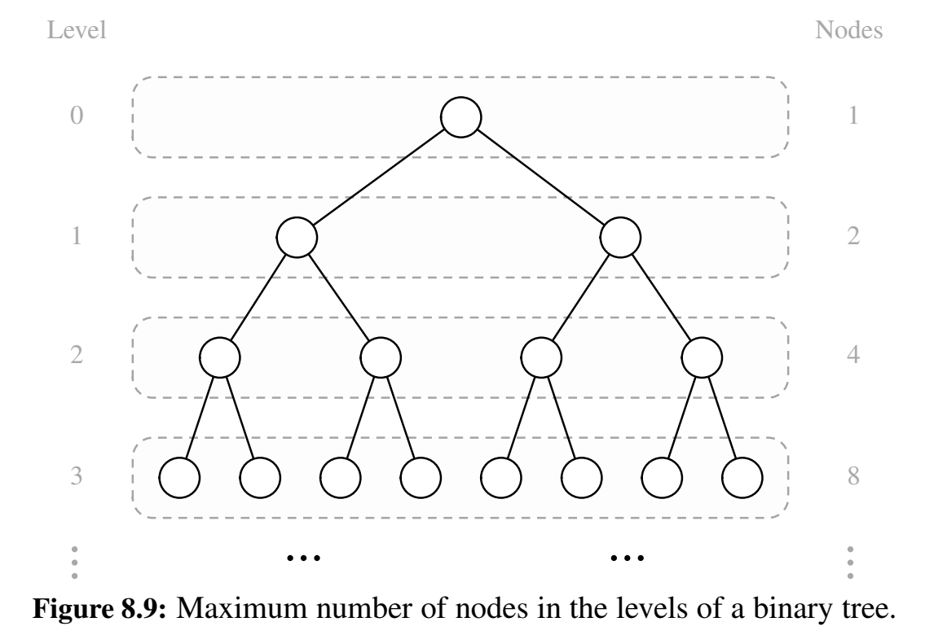

Slide 43
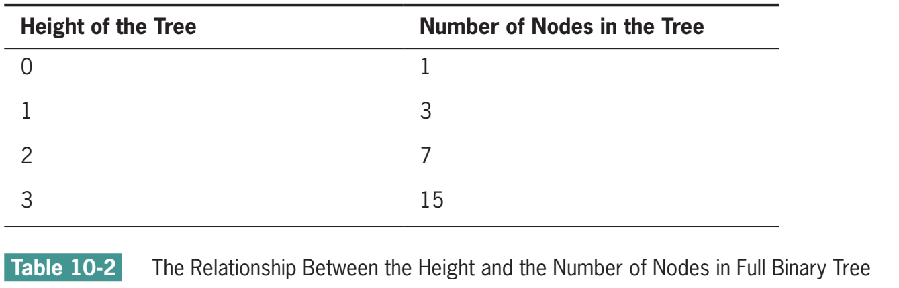
Full binary tree
Contains the maximum number of nodes for a given height H

Slide 44
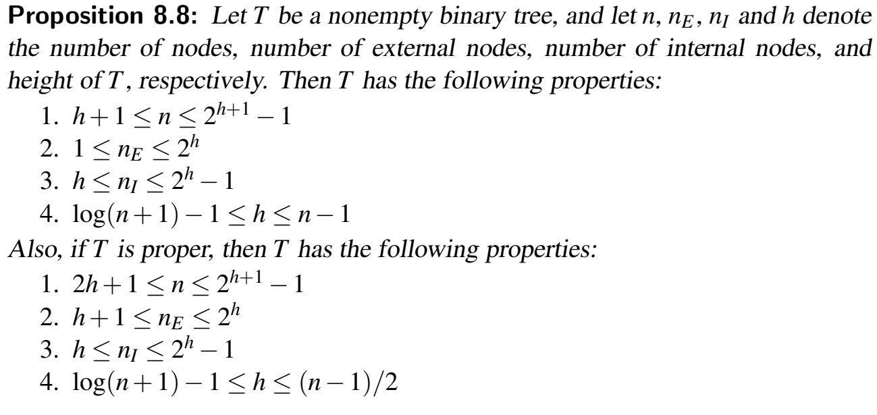

Slide 46
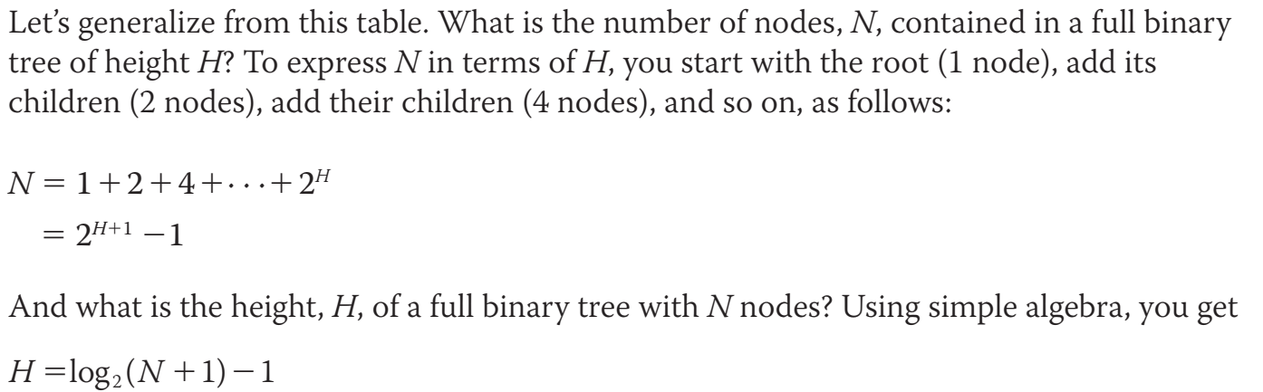
Height of full binary tree given its node

Slide 47
Binary tree
A full binary tree: level k has exactly 2^k – 1 nodes
A perfectly balanced binary tree, which includes a complete complement of nodes at each level but the last one, is bushy enough to support worst-case logarithmic access to leaf nodes.
A complete binary tree, in which any nodes on the last level are filled in from left to right, is, like a full binary tree, a special case of a perfectly balanced binary tree.

Slide 48
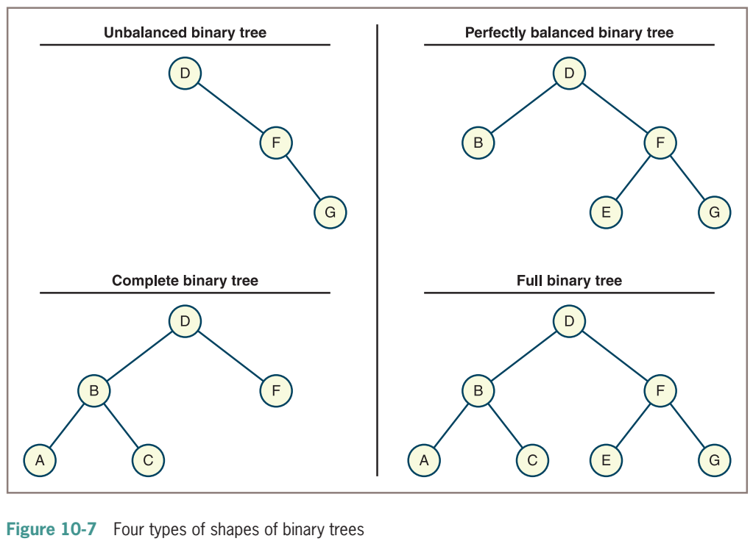

Slide 49
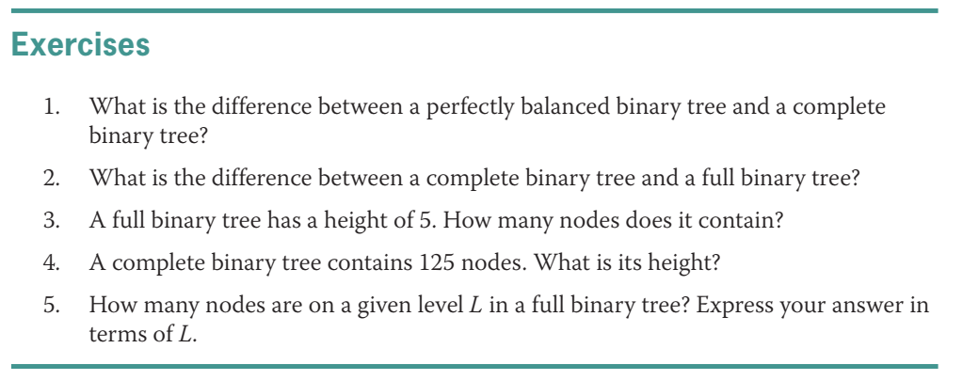

Slide 50
8.3 Implementing Trees

Slide 51
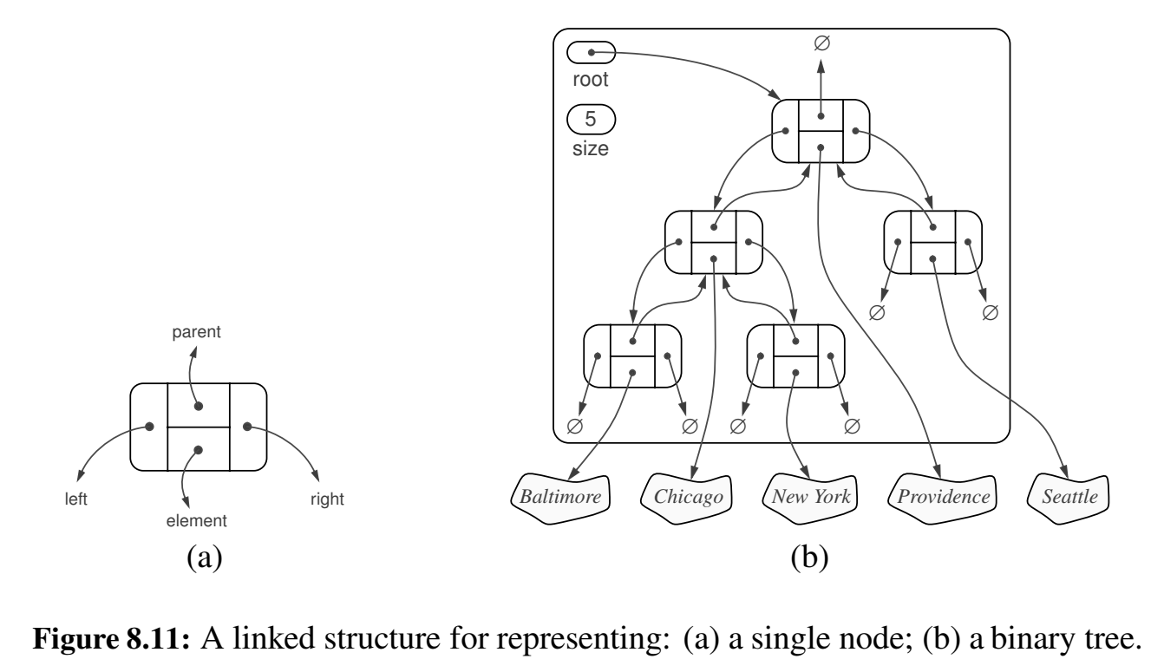
8.3.1 Linked Structure for Binary Trees

Slide 52
Python Implementation of a Linked Binary Tree Structure

Slide 53
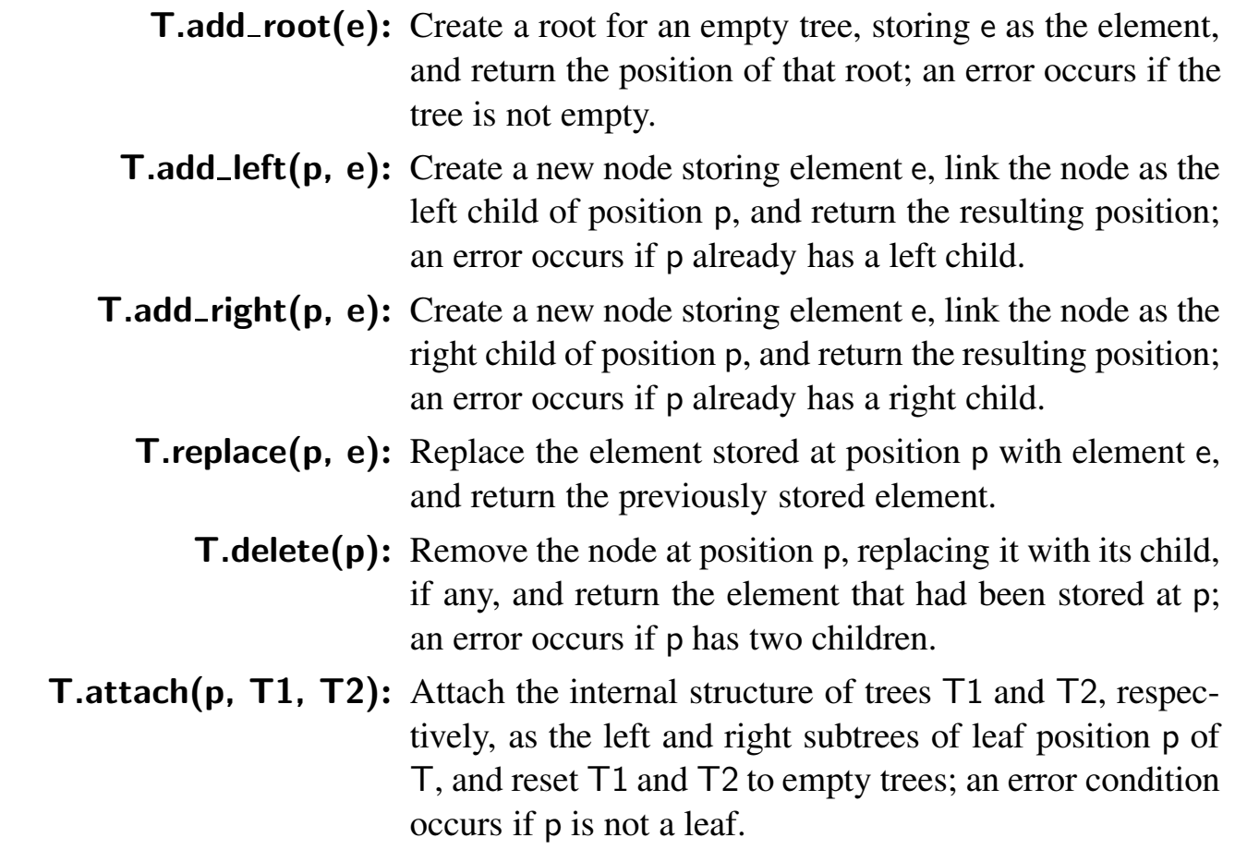
Operations for Updating a Linked Binary Tree

Slide 54
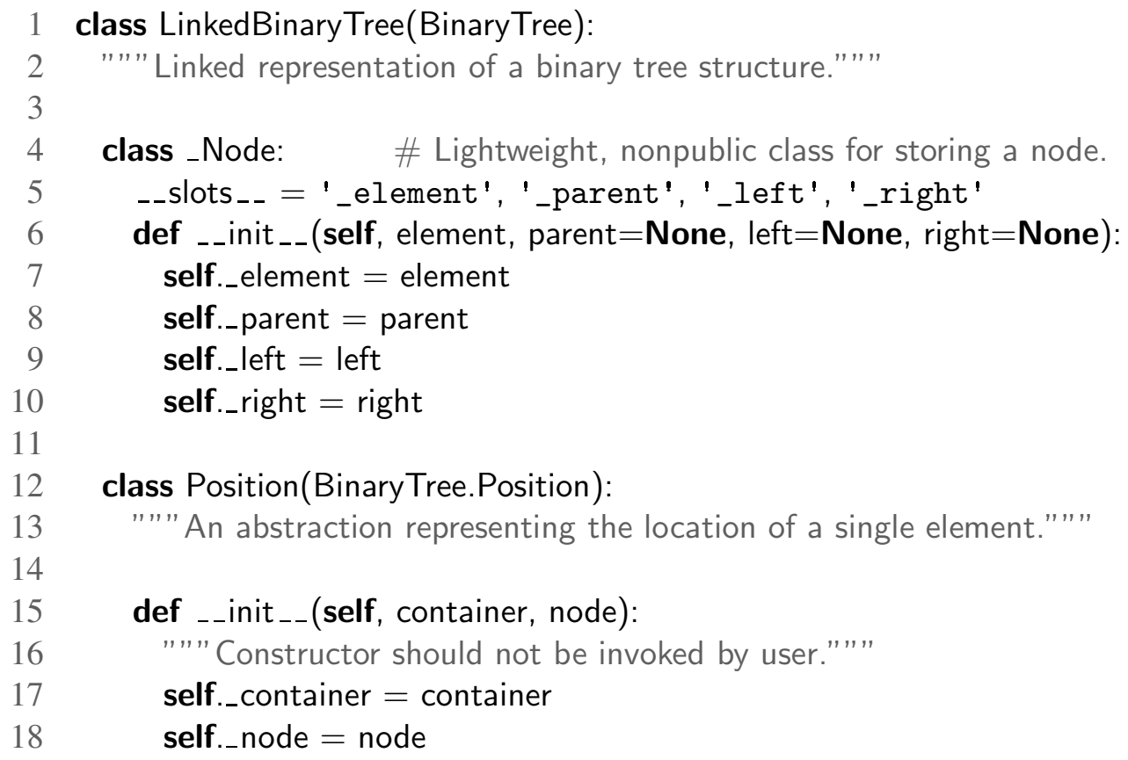

Slide 55
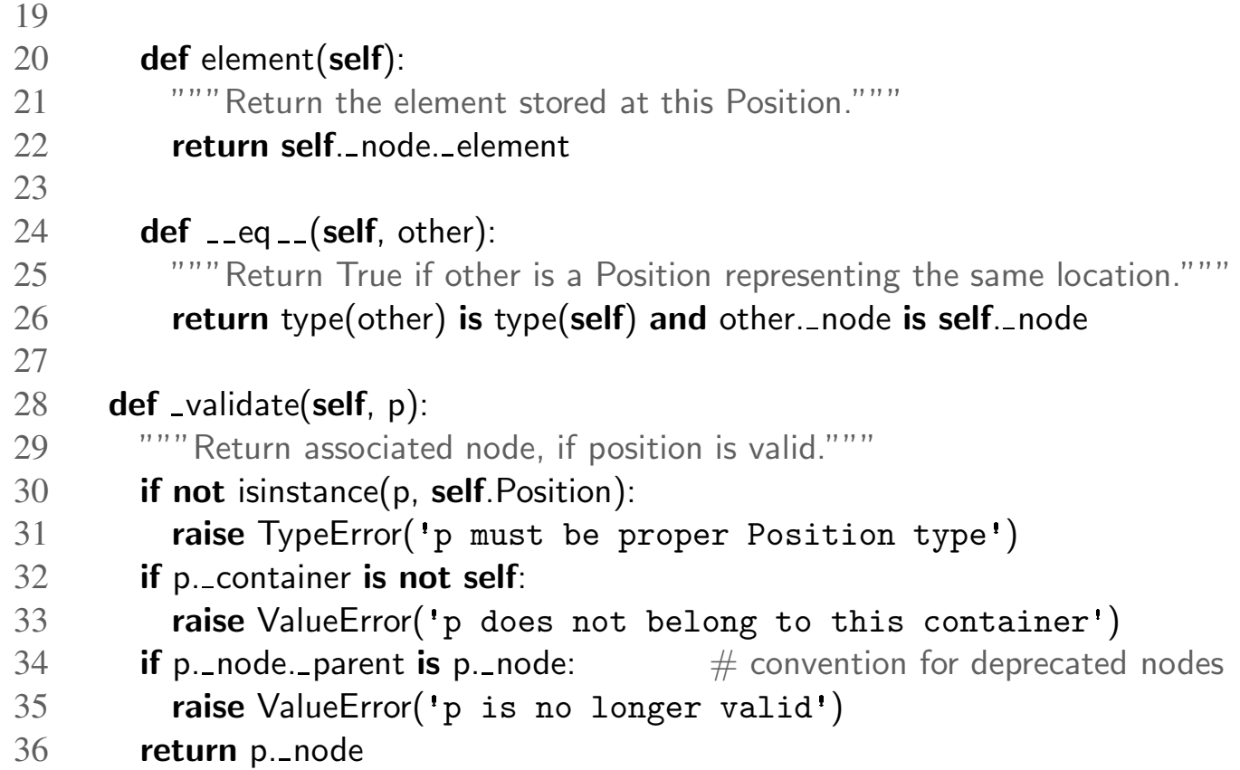

Slide 56
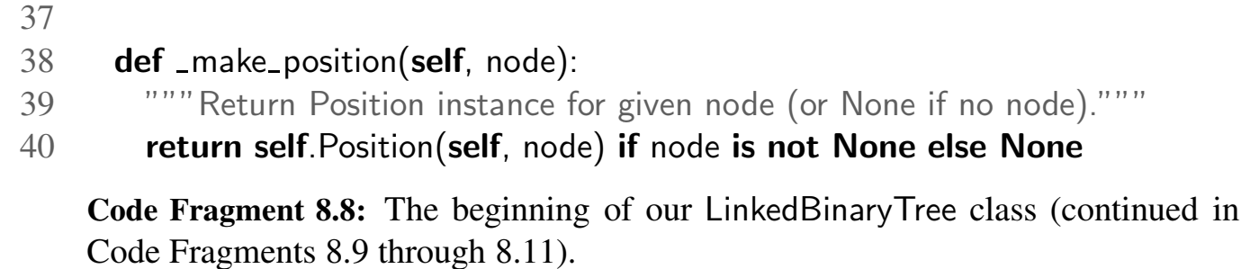

Slide 57
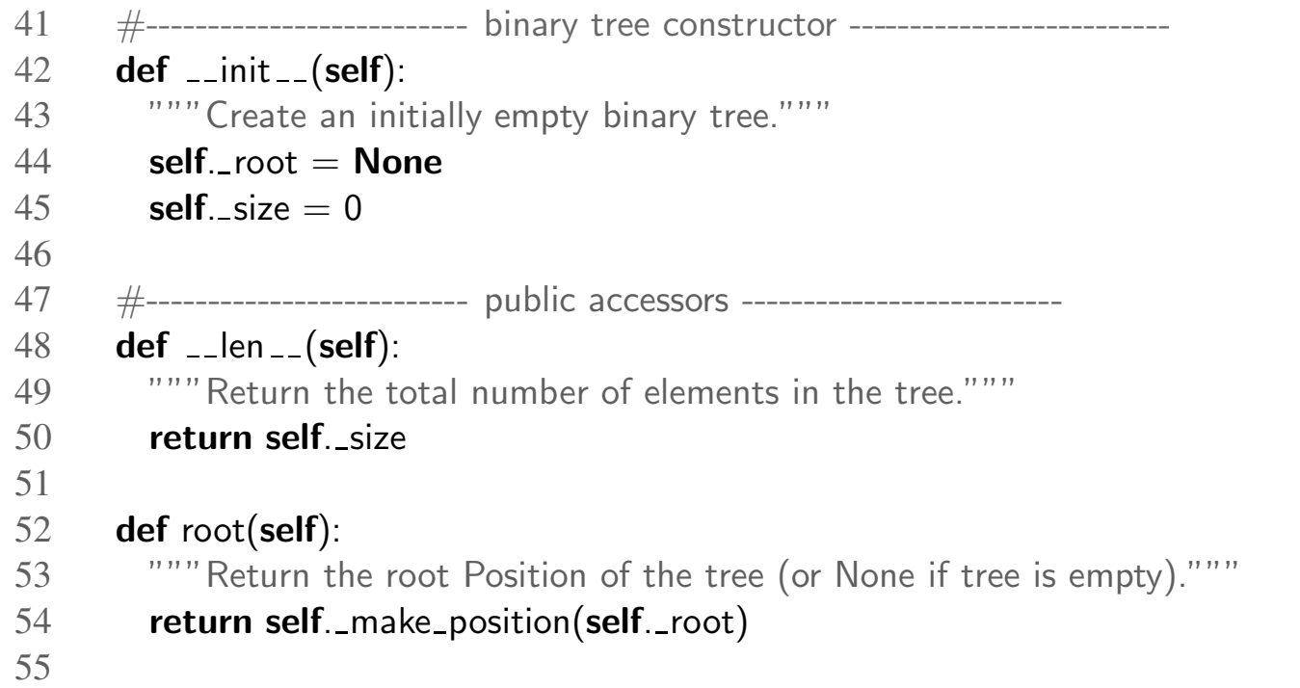

Slide 58
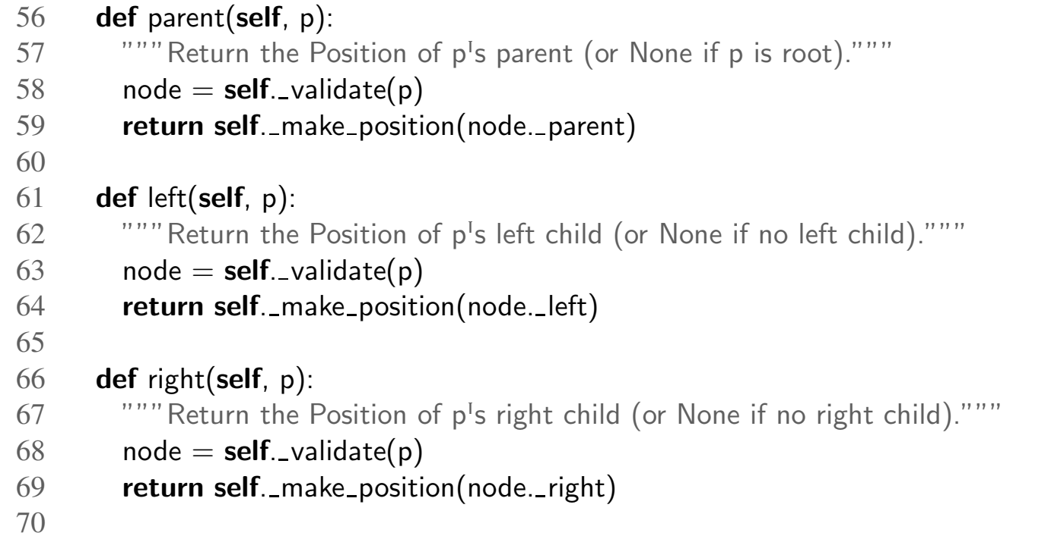

Slide 59
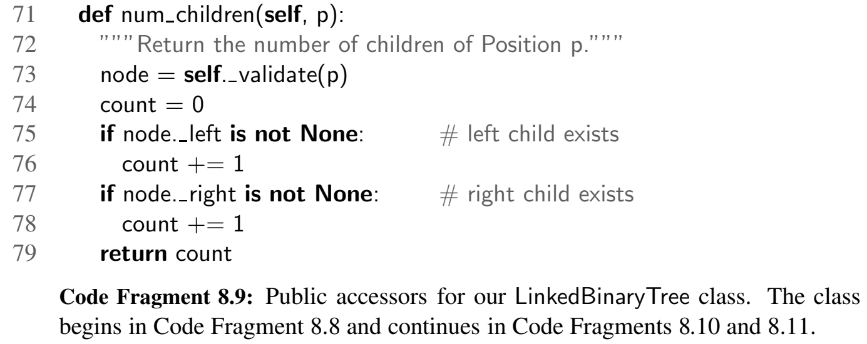

Slide 60
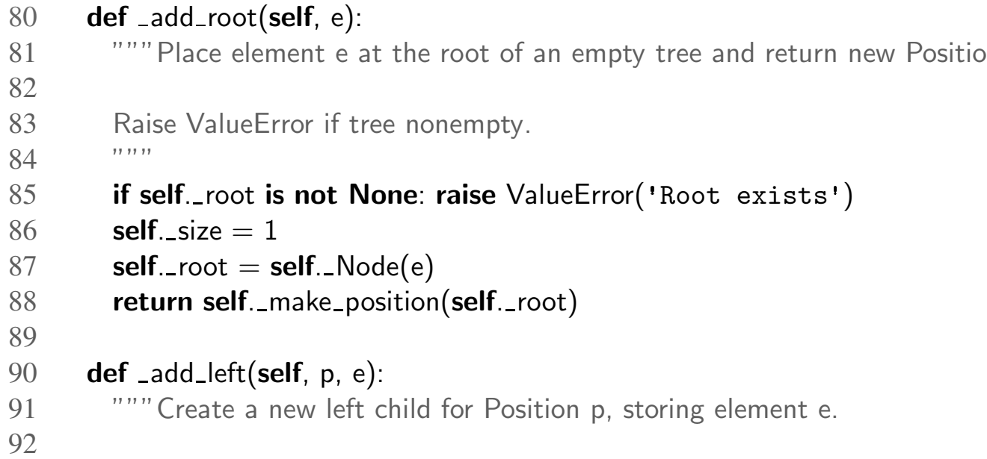

Slide 61
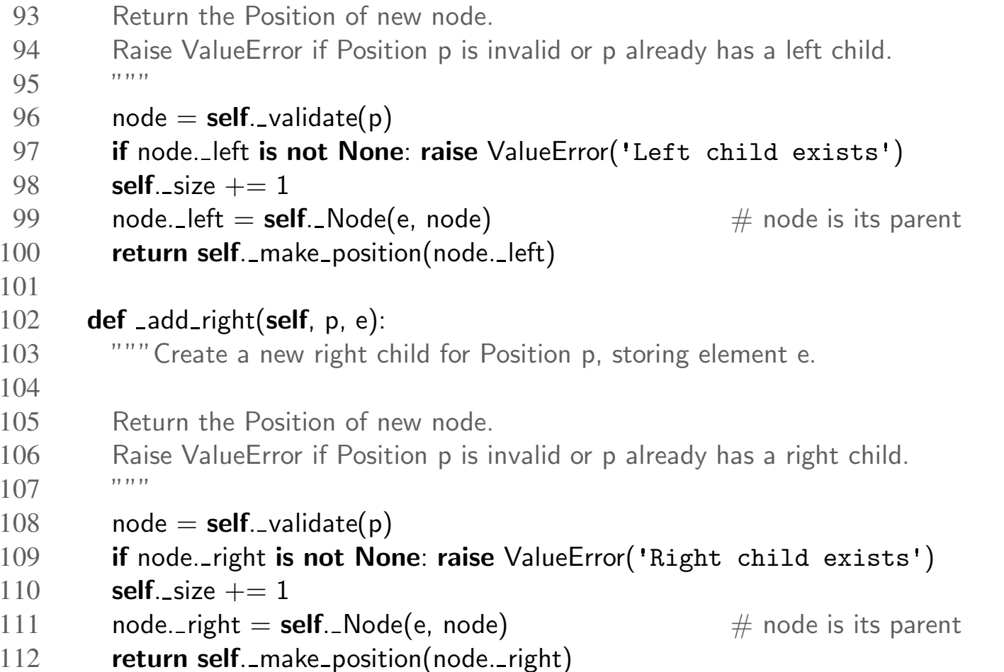

Slide 62
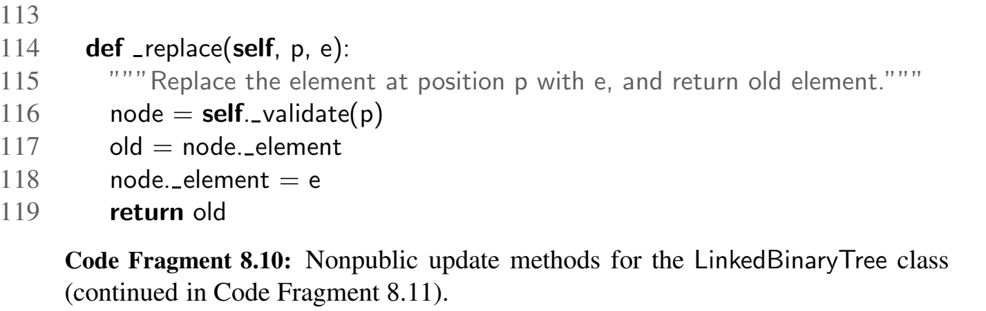

Slide 63
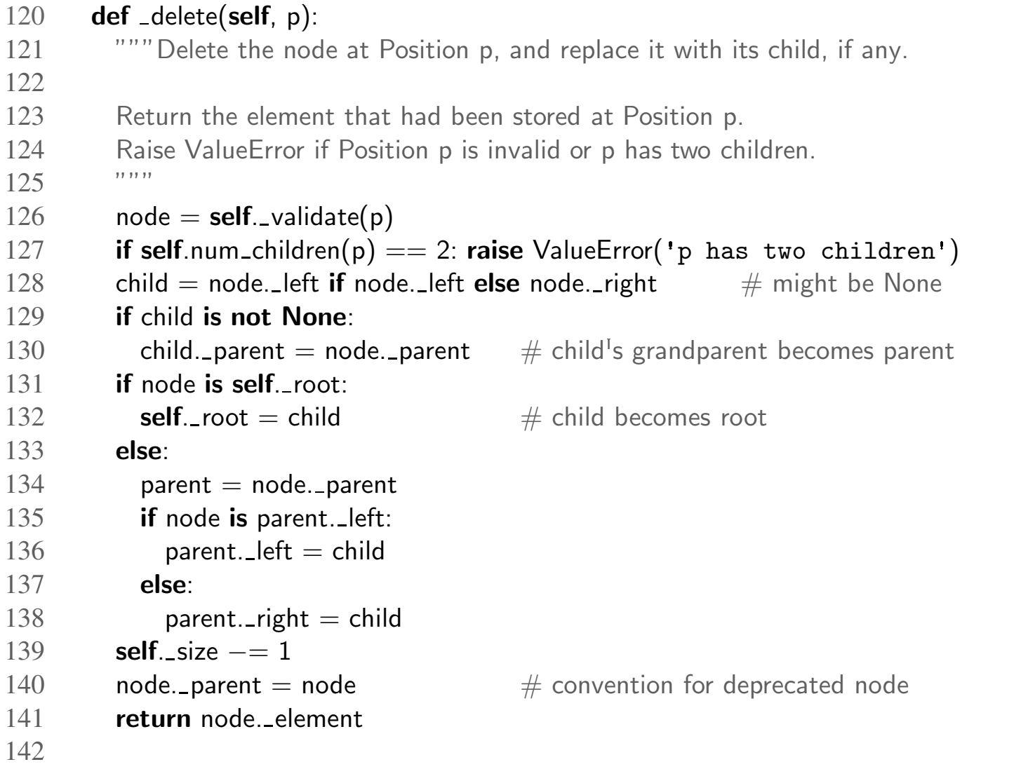

Slide 64
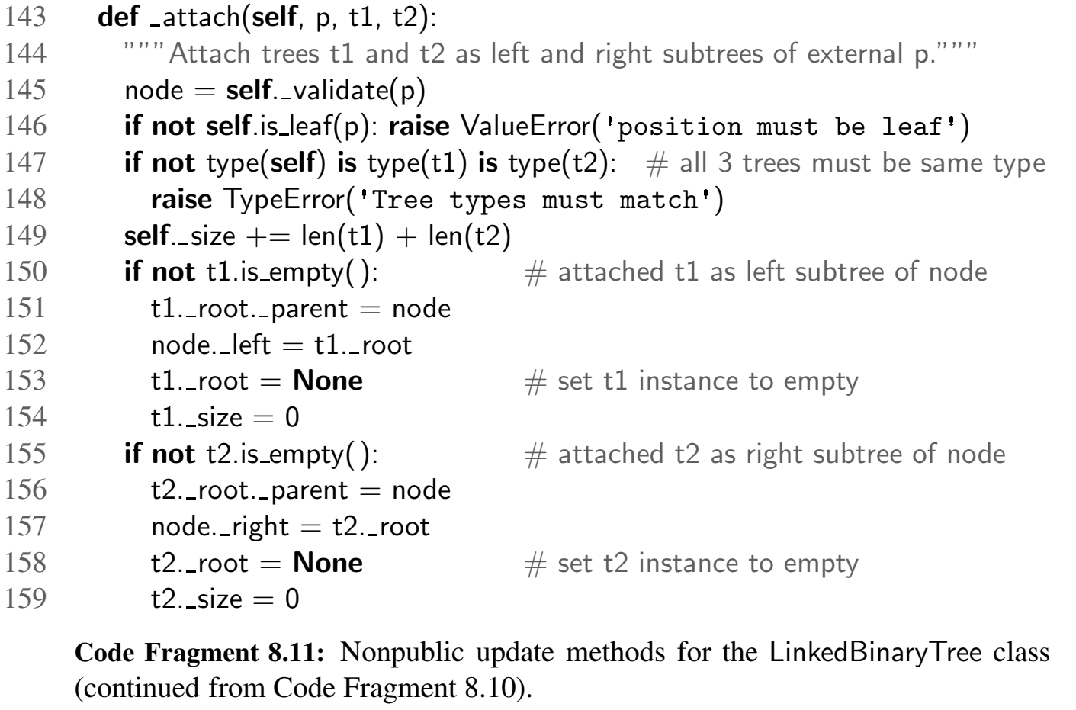

Slide 65
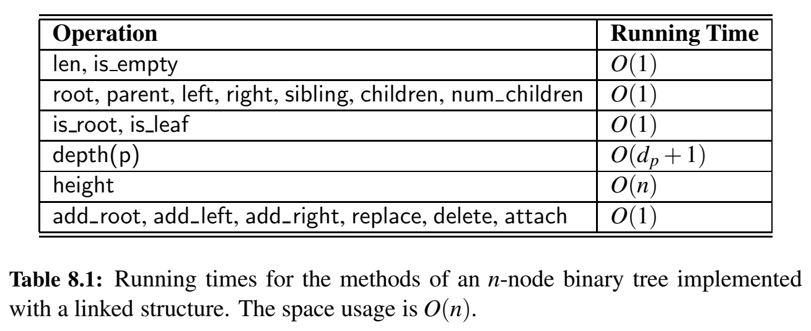

Slide 66
8.3.3 Linked Structure for General Trees

Slide 67
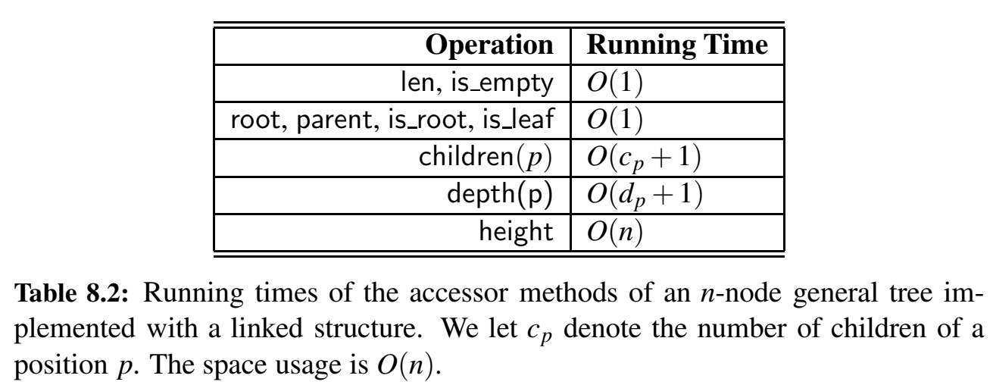

Slide 68
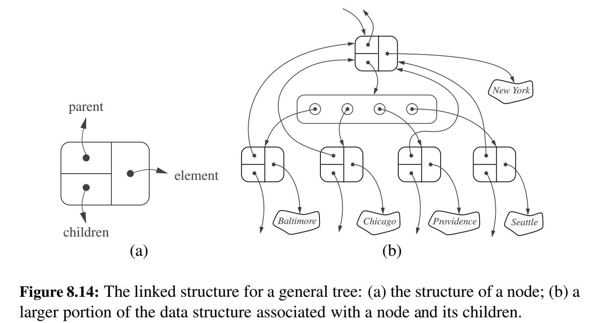

Slide 69
8.4 Tree Traversal Algorithms

Slide 70
8.4 Tree Traversal Algorithms
A traversal of a tree T is a systematic way of accessing, or “visiting,” all the positions of T .
preorder traversal: the root of T is visited first and then the subtrees rooted at its children are traversed recursively.
postorder traversal: recursively traverses the subtrees rooted at the children of the root first, and then visits the root (hence, the name “postorder”)

Slide 71
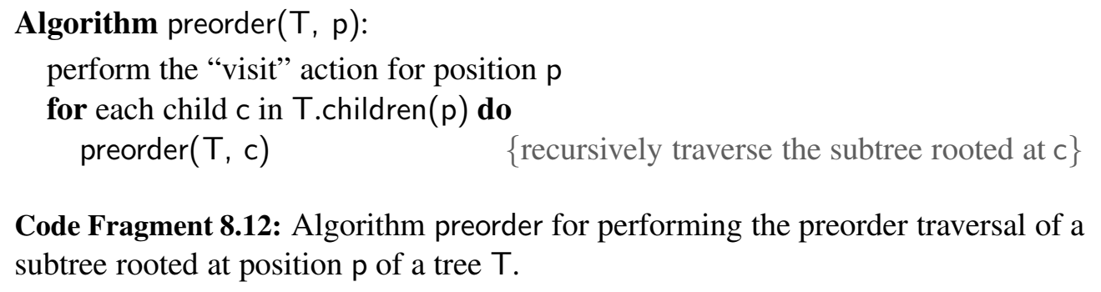
8.4.1 Preorder of General Trees

Slide 72
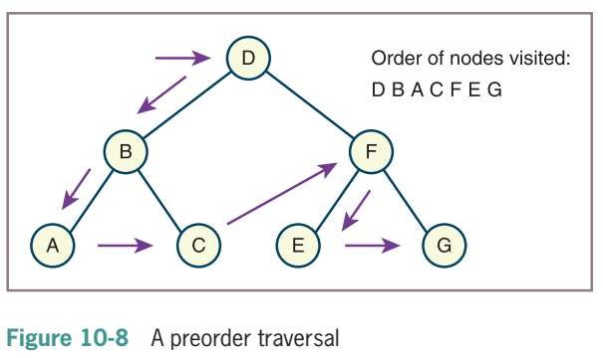
Preorder Traversal
The preorder traversal algorithm visits a tree’s root node and then traverses the left subtree and the right subtree in a similar manner.

Slide 73
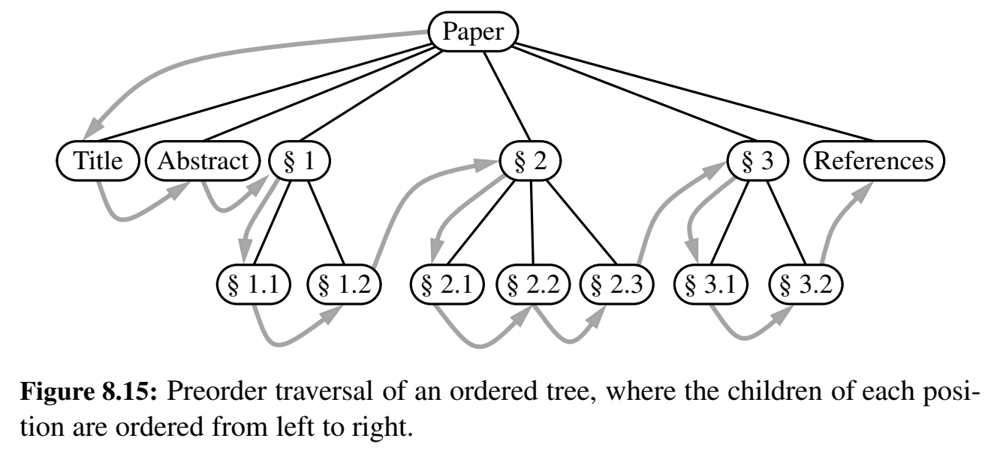

Slide 74
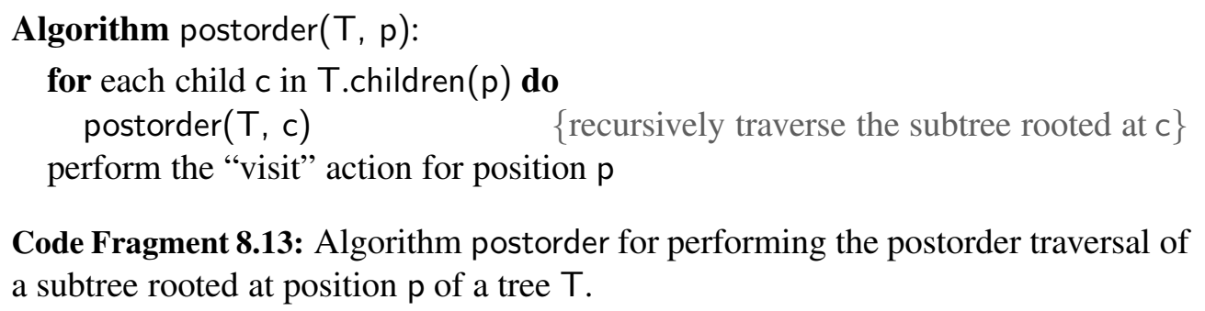
8.4.1 Postorder of General Trees

Slide 75

Postorder Traversal
The postorder traversal algorithm traverses the left subtree, traverses the right subtree, and visits the root node.

Slide 76


Slide 77

8.4.3 Inorder Traversal of a Binary Tree
inorder traversal: we visit a position between the recursive traversals of its left and right subtrees.

Slide 78


Slide 79

8.4.2 Breadth-First Tree Traversal (Level order)
breadth-first traversal: traverse a tree so that we visit all the positions at depth d before we visit the positions at depth d + 1. (non-weighted shortest path application)

Slide 80

Level order Traversal
Beginning with level 0, the level order traversal algorithm visits the nodes at each level in left-to-right order

Slide 81


Slide 82


Slide 83


